Slide 1
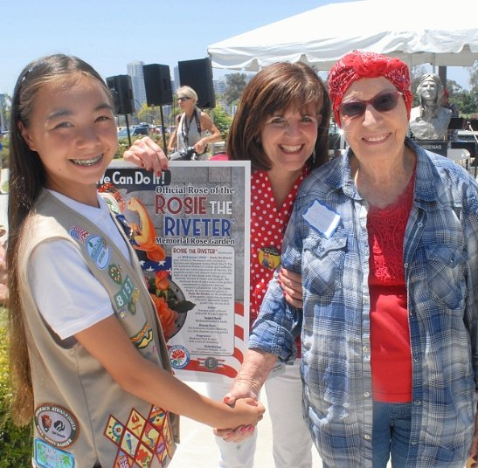
Rosie the Riveter Memorial Rose Gardens
Your event location, date, and time
WWW.Spiritof45.org/Rosies
Honoring the women who made history on Home Front during WWII

